Slide 1

The Road Home
A plan for creating permanent, affordable, and service-supported housing for Vermonters who participate in Developmental Disabilities Services
Presentation by
Kirsten Murphy, Executive Director, VT Developmental Disabilities Council

Slide 2

Act 69 – What?
Create a Plan to develop housing for individuals who participate in Developmental Disabilities Services.
Plan must have:
How long will it take to get to 600 units?
What would this cost?
Are there State policies that need to change?
Will the Plan address the full range of support needs for this group?

Slide 3
Act 69, Section 5 – Who?
Representatives from:
Agency of Human Services, Secretary’s Office
State Treasurer’s Office
Vermont Housing & Conservation Board (VHCB)
Department of Housing and Community Development
Associated General Contractors of Vermont
Vermont Care Partners
Parent-led Developmental Disabilities Housing Initiative
Green Mountain Self-Advocates
Vermont Developmental Disabilities Council
Legislature -- Senator Alison Clarkson and Rep. Ann Donahue

Slide 4
Touchstones
Every Vermonter with I/DD deserves to live with dignity, safety, and self-determination in the community they call home.
It’s not about the Building! It’s about having the right supports in place.

Slide 5
Why are we talking about this?
5% group living
39%
Living with Family
39%

Slide 6

The world has changed….
Fewer Vermonters want to be shared living providers.
New Rules, like the Settings Rule.
Medicaid says people are supposed to have choice.
Expectations of people with I/DD have changed.
Parents are aging.
Vermont has an affordable housing crisis.

Slide 7

The Act 69 Report
Provides a 13-point Plan with high priority recommendations:
5 are about how to pay for this housing
2 are about getting better information about the housing needed.
2 focus on state policies that make it harder to develop this housing.
4 are about coordinating this effort.
The recommendations work together.

Slide 8

The Act 69 Report
Ties housing to other important issues facing the DDS system of care and people with I/DD:
The Workforce Crisis
Ableism and low expectations
Quality Assurance Concerns

Slide 9

What the report does not do….
Compare housing models.

Slide 10
The 13-Point Plan
How does Vermont get to 600 units of permanent, affordable, service-supported housing?

Slide 11

Affordable
Need two things:
Money to build the housing.
A rent that people living on SSI can afford.

Slide 12
How to Pay for this Housing
Create housing vouchers that are state-funded.
Costs $1-$2 million.
Invest $10 million each year for 5 years.
Creates 50-60 units/year
Apply for federal money.
Take advantage of existing federally funded housing vouchers.
Get on waiting lists.

Slide 13

Because people have been steered away….
From housing and vouchers administered by the VT State Housing Authority and local housing authorities.
Make sure DDS participants know about Section 8 and other vouchers.
Make sure DDS participants know Section 8 vouchers can be used flexibly. For example, you can live with a service provider.
Open waiting lists for 90 days.

Slide 14

Get Better Data
Housing planners want to know how many people in a county needs this type of housing.

Slide 15

Collect data about housing needs
Case Management Organizations could ask people.
What do you want for housing now?
What do you want for housing in 3 years?
Is there anyone you want to live with?

Slide 16
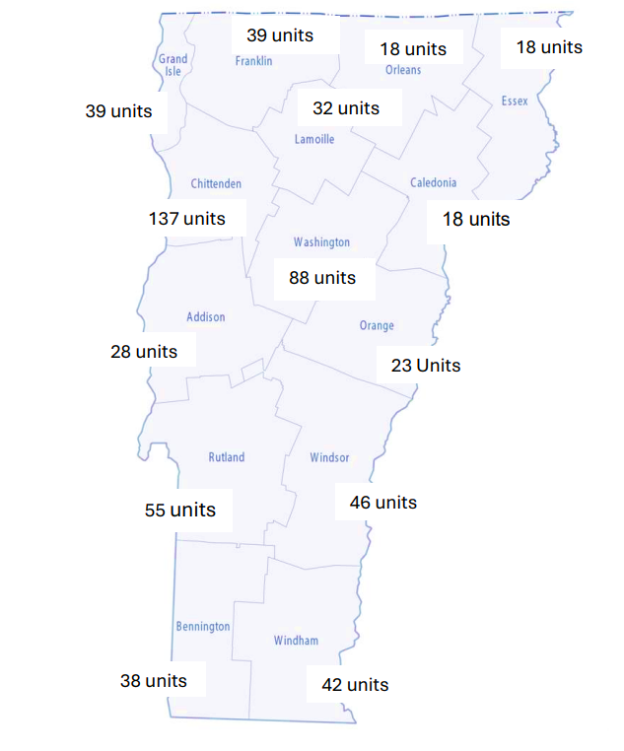
Map Data
Where in the state do people in DDS need housing?
Where are there project-based vouchers?

Slide 17

Licensing
Homes where more than 2 DDS participants live usually need a license.
There are 3 types of license:
Therapeutic Community Residence (TCR) – 7 homes
Residential Care, level 3 – 11 homes
Residential Care, level 4 – none right now
There are also some group living settings that are not licensed.

Slide 18
Licensing, continued
Positive Things:
Negative Things:
Licensing can make sure there are strong health and safety measures.
Licensing can protect individual rights.
Can limit the autonomy of residents.
Some rules can make a house feel less “homelike.”
Some rules add cost, because staff do more reporting and checking that rules are followed.

Slide 19
Licensing, continued
If more than 2 people receiving services live in a home, should a license always be required?
There are only three types of license available in the DD system.
The three types of license are not a good fit for some of the housing people want.
RECOMMENDED: DAIL “fast track” a study to figure out the best way to solve this problem.

Slide 20

Residences not run by DA/SSAs
Are not paid enough money to deliver the services their residents need.
Are heavily dependent on fundraising. Not sustainable. Not scalable.
RECOMMENDED: A group is working on this. Continue to use the tools of payment reform to figure out a fair way to fund residential services when they are not run by DA/SSAs

Slide 21
Coordinating Future Housing Development
Advisory Committee
* Time limited.
* Annual report to the legislature.
AHS and DAIL Staff
Housing Navigator at Land Access and Opportunity Board

Slide 22

This must be a statewide effort. How do we bring all the agencies into this work?

Slide 23
Answering the Legislature’s Questions
1. How long will it take to get to 600 units?
Vermont could be well on its way in 5 years.
What would this cost?
Report suggests $56 to $61 million over 5 yrs.
Are there State policies that need to change?
Very likely. Need to address licensing & paying non-agency operated settings.
4. Will the Plan address the full range of support needs for this group?
Yes, if we plan carefully, coordinate efforts,
use good data

Slide 24

The Big Picture
Workforce
Continue and expand initiatives aimed at increasing the number of well-trained direct support and residential services staff.
Ableism
Educate widely about self-advocacy, the dignity of risk, disability rights, and the value of community inclusion.
Quality Assurance
Continue to build DDSD’s capacity for quality monitoring. Share the results of these activities transparently with state leaders, self-advocates, and family members.

Slide 25
For more information
Report, meeting minutes: https://accd.vermont.gov/housing/partners/act-69-2025
Video version of this presentation is also available.
Kirsten.Murphy@Vermont.gov

