Slide 1


Cannabis Control Board Introduction
January 9, 2026

Slide 2

Market Overview

Slide 3
History of Cannabis Policy – Vermont
2004: Legislature legalizes medical cannabis
2011: Legislature permits the establishment of medical-marijuana dispensaries
2013: Legislature decriminalizes possession of up to 1 oz. of cannabis for personal use
2017: Governor Scott establishes a Marijuana Advisory Commission to consider commercial cannabis
2018: Vermont becomes the first state to legalize cannabis (home grow / possession) through state legislature
2020: Legislature legalizes commercial adult-use cannabis sales and creates the Cannabis Control Board (Act 164)
2022: First legal commercial sales of cannabis

Slide 4



Introduction
The Cannabis Control Board (CCB) is a three-member independent executive branch agency that was established through Act 164 of 2020 for the purpose of safely, equitably, and effectively implementing and administering the laws and rules regulating adult- and medical-use cannabis (marijuana) in Vermont.
James Pepper (Chair)
Kyle Harris
Julie Hulburd

Slide 5
Market Structure
§ 904a. SMALL CULTIVATORS
It is the intent of the General Assembly to move as much of the illegal cannabis market as possible into the regulated market for the purposes of consumer protection and public safety. It is also the intent of the General Assembly to encourage participation in the regulated cannabis market by small, local farmers. In furtherance of these goals, the Board shall consider policies to promote small cultivators as defined in section 861 of this title.
§ 883(b) - Criminal History Records
The Board shall adopt rules that set forth standards for determining whether an applicant should be denied a cannabis establishment license because of his or her criminal history record based on factors that demonstrate whether the applicant presently poses a threat to public safety or the proper functioning of the regulated market. Nonviolent drug offenses shall not automatically disqualify an applicant.
§ 901(d)(3) - One license type per entity
…[A]n applicant and its affiliates may obtain a maximum of one type of each type of license as provided in subdivisions (1)(A)–(E) of this subsection (d). Each license shall permit only one location of the establishment.

Slide 6

Adult-Use Program License Count History

Slide 7
Adult-Use Program Licensing Overview

Slide 8
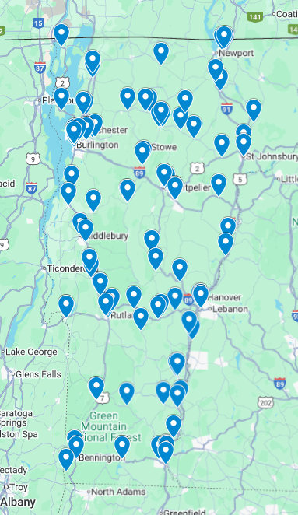
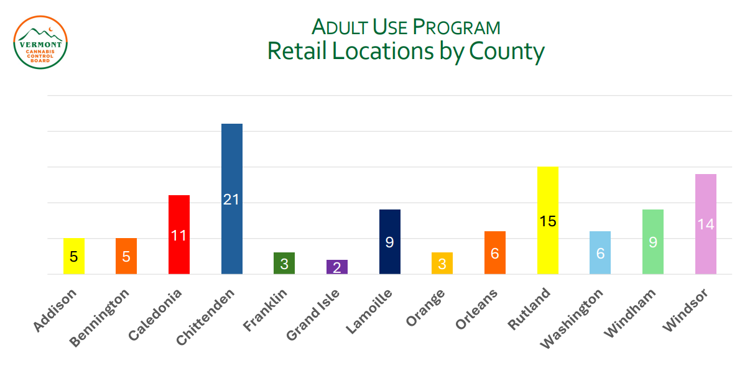
Market Structure

Slide 9
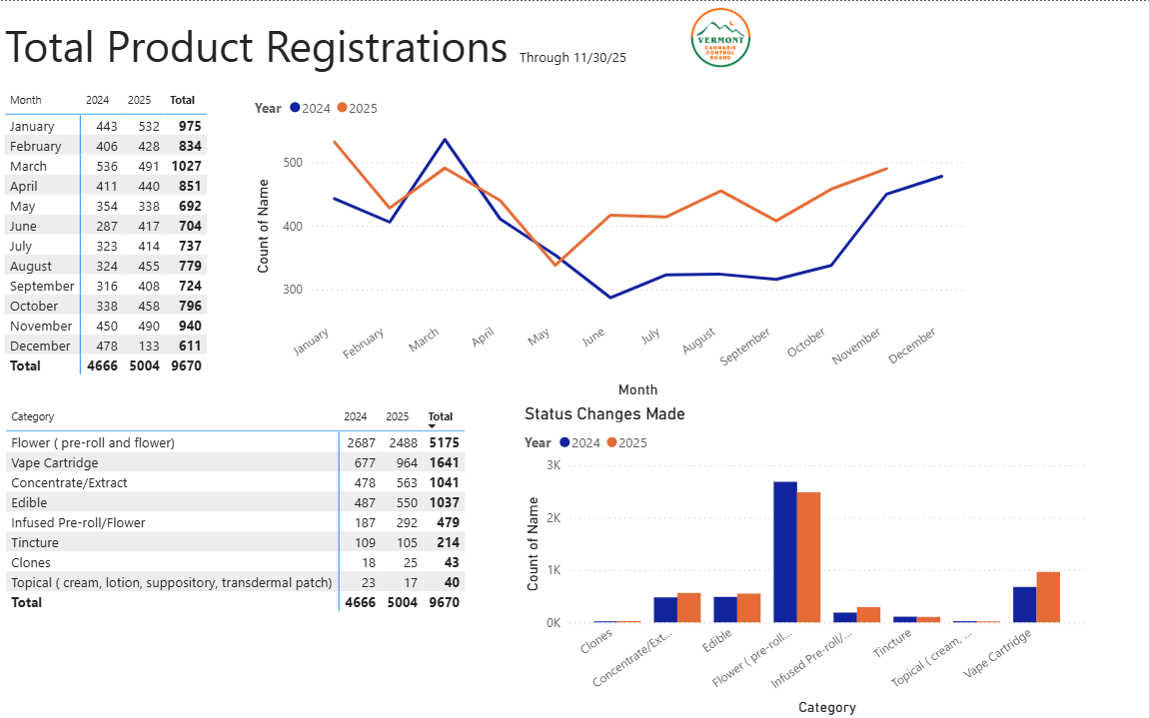
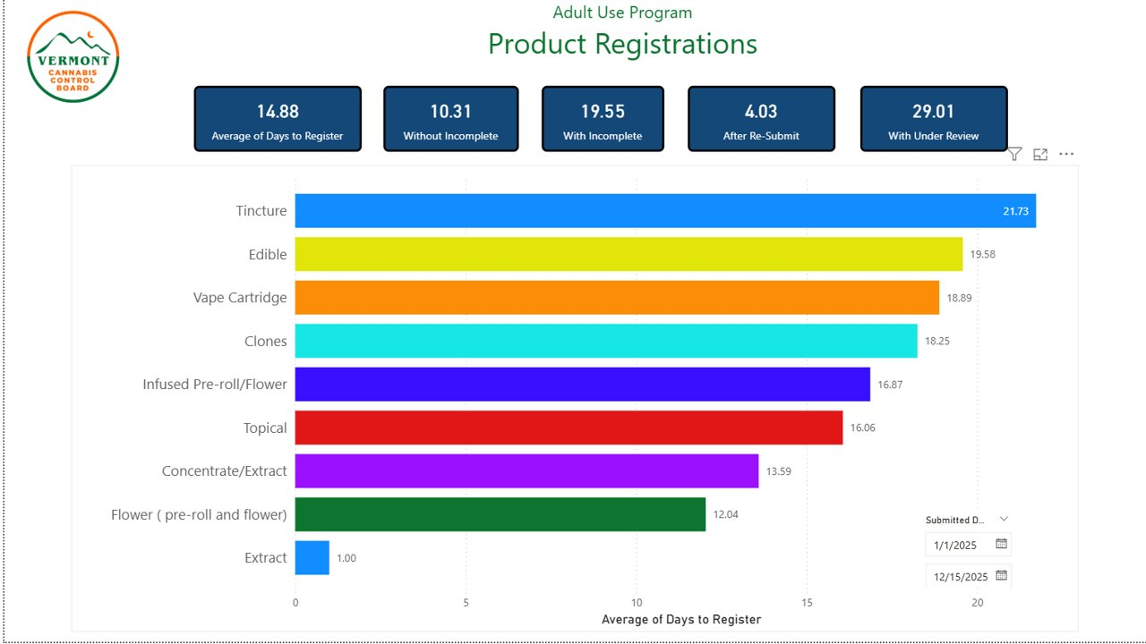
Product Registrations

Slide 10
Medical Program Overview
Total Number of Med Dispensaries (3) and Medically-endorsed businesses (22)
Total Patients (3,043) and Caregivers (131)

Slide 11
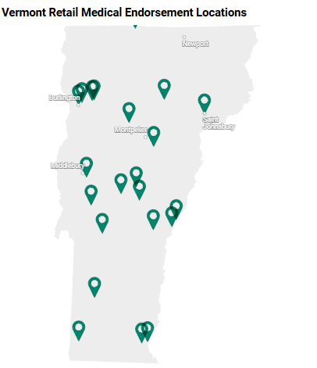
Medical Program Overview
Total Number of Med Dispensaries (3) and Medically-endorsed businesses (22)
Middlebury (2)
Montpelier
Randolph
Rutland (2)
Saint Johnsbury
South Hero
Waterbury Center
White River Junction
Winooski
Woodstock
Bennington
Bethel
Brandon
Brattleboro (2)
Burlington
Essex
Essex Junction
Johnson
Manchester Center
Notes:
This final medical program slide shows a map and list of medically endorsed locations as of the end of 2025. Overall, medical access is fairly well distributed across the state. The primary gap we continue to see is in the northern part of the state, where fewer medically endorsed establishments are currently operating.

Slide 12
Compliance Data

Slide 13
Compliance and Enforcement Overview FY25

Slide 14
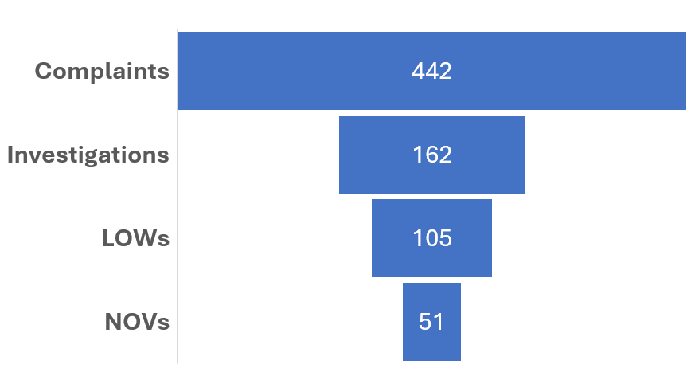
Compliance and Enforcement Overview
Calendar Year 2025

Slide 15
Compliance and Enforcement Data
Complaints and Warnings

Slide 16
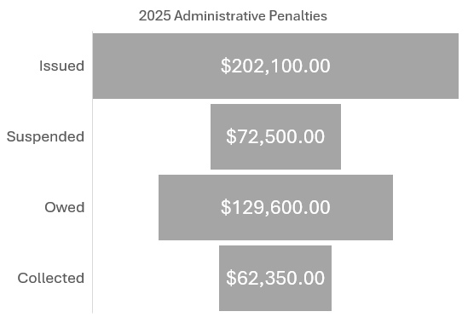
Compliance and Enforcement Data
Notices of Violation and Administrative Penalties

Slide 17
Trends

Slide 18
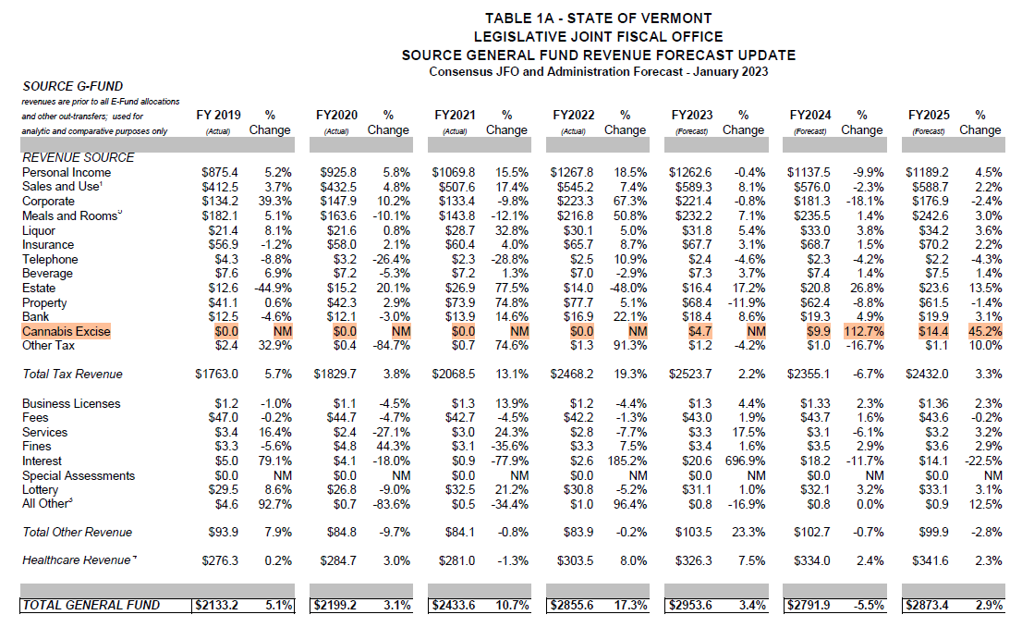
Trends
Excise Tax Forecast
January 2023
FY23 – 4.7M
FY24 – 9.9M
FY25 – 14.4M

Slide 19
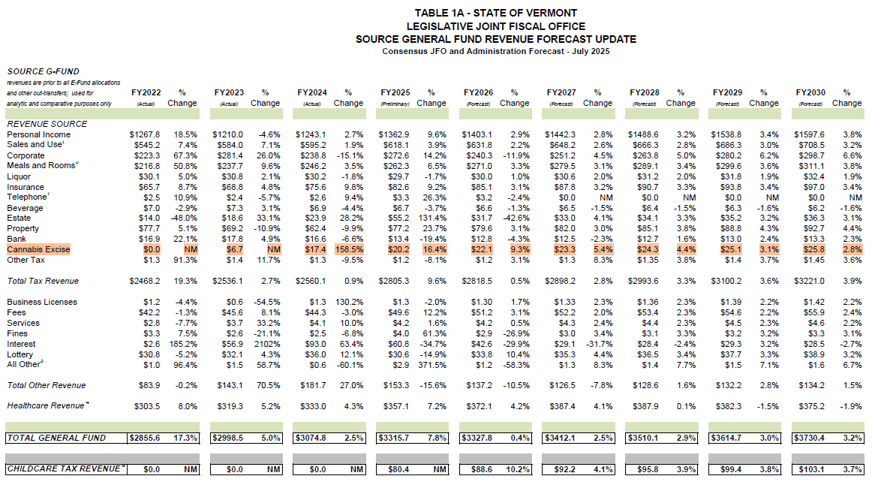
Trends
Excise Tax Actual
July 2025
FY23 – 6.7M (+43%)
FY24 – 17.4M (+76.8%)
FY25 – 20.2M (+40%)
Forecast
FY26 – 22.1M
FY27 – 23.3M
FY28 – 24.3M
FY29 – 25.1M
FY30 – 25.8M

Slide 20
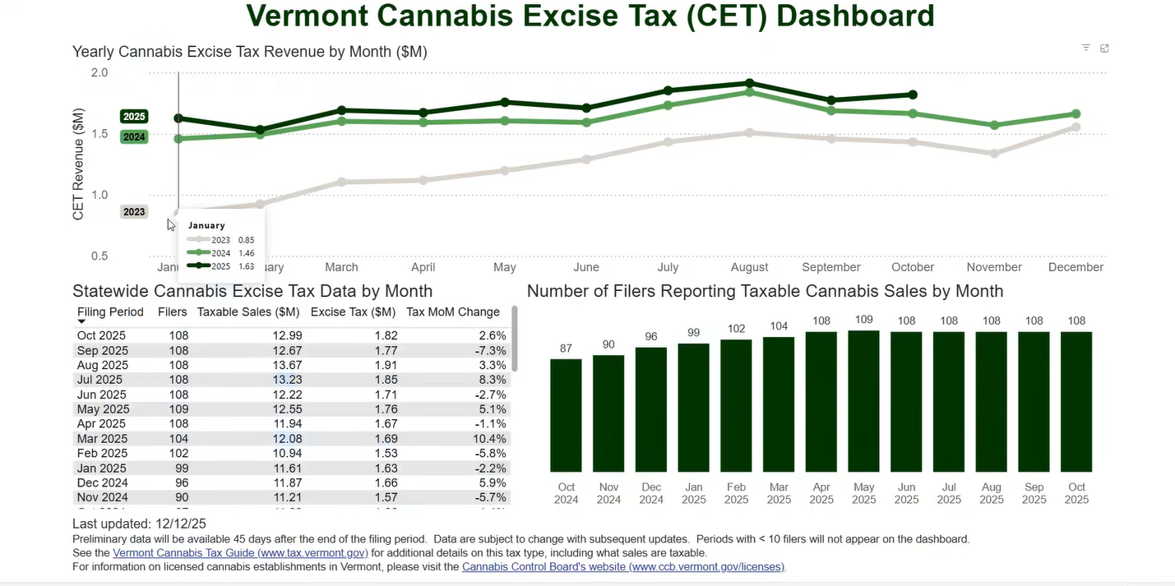

Slide 21
Trends
Market Dynamics and Oversupply
• Seasonal Oversupply: Annual fall harvest leads to price compression and smaller margins, disproportionately impacting outdoor cultivators.
• Demand Volatility: A significant portion of demand for regulated cannabis is driven by non-residents (tourists, border consumers). Decreases in tourism or the implementation of adult-use programs in neighboring states immediately reduce demand for Vermont-grown cannabis.
• Illicit Market Competition: Regulated cannabis is in fierce competition with the illicit market and the intoxicating hemp-derived market. Both enjoy advantages in price and convenience, as they are not subject to regulatory oversight, potency caps, delivery bans, or excise taxes.

Slide 22
Trends
Structural Challenges (Federal Conflict)
• Regulatory Compliance: Product testing, seed-to-sale tracking, child-resistant, non-plastic packaging, and security requirements are among the many costs borne by cannabis businesses that do not apply to other small businesses.
• Banking & Finance: Most federally chartered banks and credit card processors avoid cannabis establishments, forcing reliance on high-interest loans or personal capital for start-up and operating expenses.
• IRS Code §280E: This section of the tax code explicitly prohibits cannabis establishments from deducting normal business expenses (e.g., rent, payroll, utilities) from their federal tax returns.
• Insurance: Businesses rely exclusively on unlicensed surplus line insurers, who generally charge higher premiums than admitted carriers.
• Small Business Support: Traditional state and federally funded small business assistance programs or economic development opportunities are generally unavailable to cannabis entrepreneurs.
• Advertising: In an effort to avoid promoting consumption or marketing to youth, the legislature enacted stringent advertising restrictions for cannabis establishments that inhibit the ability to establish a customer base.

Slide 23
Federal Landscape

Slide 24
Rescheduling
INCREASING MEDICAL MARIJUANA AND CANNABIDIOL RESEARCH
December 18, 2025
Sec. 2. Rescheduling Medical Marijuana and Improving Access to Cannabidiol Products.
(a) The Attorney General shall take all necessary steps to complete the rulemaking process related to rescheduling marijuana to Schedule III of the CSA in the most expeditious manner in accordance with Federal law, including 21 U.S.C. 811.
Rescheduling marijuana to Schedule III would:
• Remove the applicability of section 280E of the federal tax code, allowing marijuana businesses to deduct all standard business expenses in accordance with federal law, even if the Schedule III marijuana product is not a U.S. Food and Drug Administration (FDA) approved drug.
• Potentially make it easier to obtain and maintain a U.S. Drug Enforcement Administration (DEA) registration as a Schedule III research facility to research marijuana.

Slide 25
Rescheduling
Rescheduling marijuana to Schedule III would not:
require cannabis products to be prescribed by a doctor and accessed through a pharmacy
  Because state-regulated cannabis products are not FDA-approved drugs, they do not meet current requirements as prescribed Schedule III drugs
permit interstate commerce of state regulated cannabis products
  Interstate commerce for Schedule III drugs requires approval from the FDA and necessary approvals and licenses under the controlled substances act as issued by the DEA
increase banking and financial access
  The illegal commerce and sale of a Schedule III substance still violates the Controlled Substances Act and current U.S. Banking Requirements. Thus, existing industry guidance under Financial Crimes Enforcement Network (FinCEN) of the U.S. Department of Treasury still applies and the status quo is maintained in terms of industry access to financial services
For additional information please see: Overview of the Implications if Marijuana is Rescheduled to Schedule III under the U.S. Controlled Substances Act, December 2025

Slide 26
Hemp-derived products
Agricultural Improvement Act of 2018 (“2018 Farm Bill”)
7 USC 1639o
(1)Hemp.–The term “hemp” means the plant Cannabis sativa L. and any part of that plant, including the seeds thereof and all derivatives, extracts, cannabinoids, isomers, acids, salts, and salts of isomers, whether growing or not, with a delta-9 tetrahydrocannabinol concentration of not more than 0.3 percent on a dry weight basis.

Slide 27
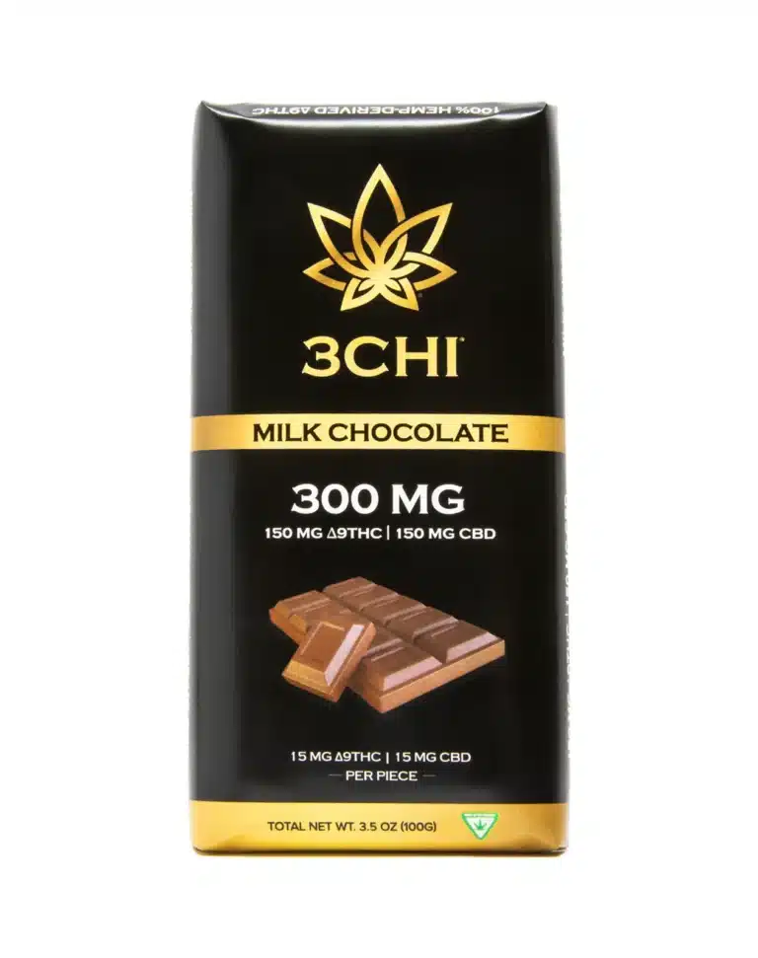
Hemp-derived products
“0.3% loophole”:
Applying the 0.3% concentration threshold to heavier products results in greater amounts of THC. For example, a 50-gram chocolate bar could have around 150 mg of THC and still be compliant with the 0.3% THC threshold.

Slide 28
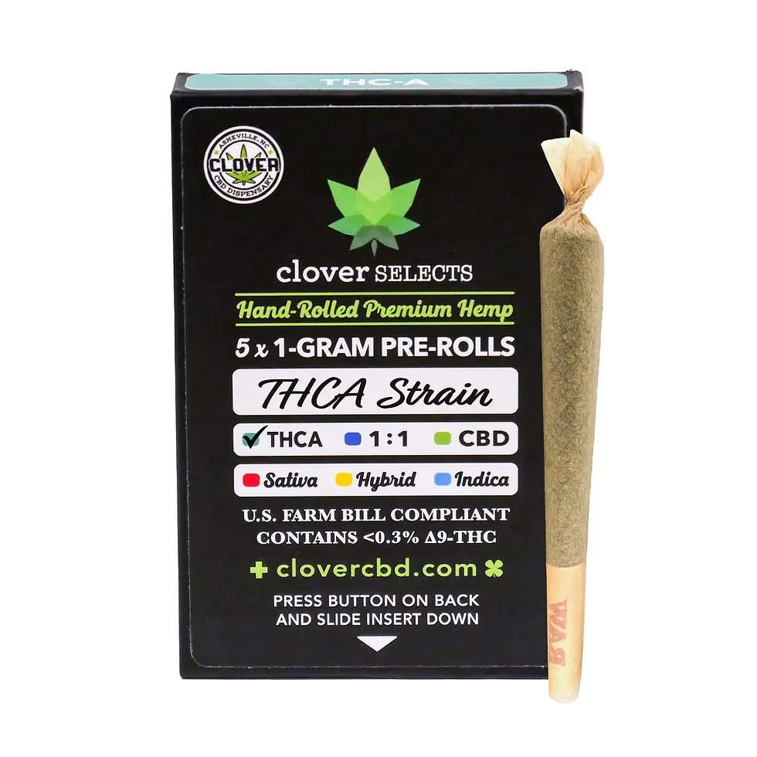
Hemp-derived products
“THCA loophole”:
The 0.3% threshold specifically applies to “delta-9 THC.” As written, it does not include delta-9 THCA (the precursor to THC) which readily converts into THC when smoked, heated, or combusted.

Slide 29
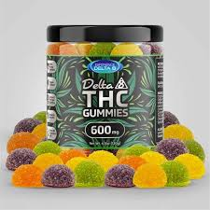
Hemp-derived products
“Derivatives loophole”:
The definition of hemp also includes “all derivatives” of the cannabis plant. As a result, many hemp businesses are taking CBD (cannabidiol) derived from hemp and chemically converting it into intoxicating cannabinoid derivatives like delta-8 THC, THCO acetates, and HHC, none of which have been well-studied for human safety.

Slide 30
Hemp-derived products
FY2026 Agriculture, Rural Development, Food and Drug Administration, and Related Agencies Appropriations Act
Per Container Limit: Final consumer products are limited to a maximum of 0.4 milligrams of combined total THC per container, a threshold that industry experts argue would eliminate approximately 99% of currently available products, including many non-intoxicating CBD items that contain trace amounts of THC.
Total THC Limit: The 0.3% THC threshold now applies to the total THC concentration, which includes delta-9 THC, delta-8 THC, tetrahydrocannabinolic acid (THCA), and any other cannabinoids determined by the Secretary of Health and Human Services to have similar effects to THC.
Synthetic and Manufactured Cannabinoids: The law explicitly excludes cannabinoids that are synthesized or manufactured outside the Cannabis sativa plant, directly targeting products like delta-8 and delta-10 THC that grew in popularity under the 2018 Farm Bill framework.
Effective date: November 12, 2026

Slide 31
Market Expansion and Investment

Slide 32
Market Expansion
Event licensing for sales (farmers markets)
Event licensing for on-site consumption (weddings, festivals, concerts, etc.)
THC potency cap on
-serving size
-package limit
-flower
-solid concentrates
Delivery
Consumption cafe
Retail opt in/out
Advertising
2-year product registration and employee ID cards

Slide 33
Market Investment
Section 12a of Act 56 (2025) directs the Cannabis Control Board to recommend whether a portion of the cannabis excise tax established pursuant to 32 V.S.A. § 7902 should be allocated to the Cannabis Business Development Fund for uses as provided pursuant to 7 V.S.A. § 987 and the Vermont Land Access and Opportunity Board to fulfill the duties of the Board.
§ 987. CANNABIS BUSINESS DEVELOPMENT FUND
There is established the Cannabis Business Development Fund, which shall be managed in accordance with 32 V.S.A. chapter 7, subchapter 5.
The Fund shall comprise:
(1) a one-time contribution of $50,000.00 per integrated license to be made on or before October 15, 2022; and
(2) monies allocated to the fund by the General Assembly.
(c) The Fund shall be used for the following purposes:
(1) to provide low-interest rate loans and grants to social equity applicants to pay for ordinary and necessary expenses to start and operate a licensed cannabis establishment;
(2) to pay for outreach that may be provided or targeted to attract and support social equity applicants;
(3) to assist with job training and technical assistance for social equity applicants; and
(4) to pay for necessary costs incurred in administering the Fund

