Slide 1
How the Budget is Structured
Senate Committee on Appropriations
Grady Nixon, Fiscal Editor
January 16, 2025

Slide 2
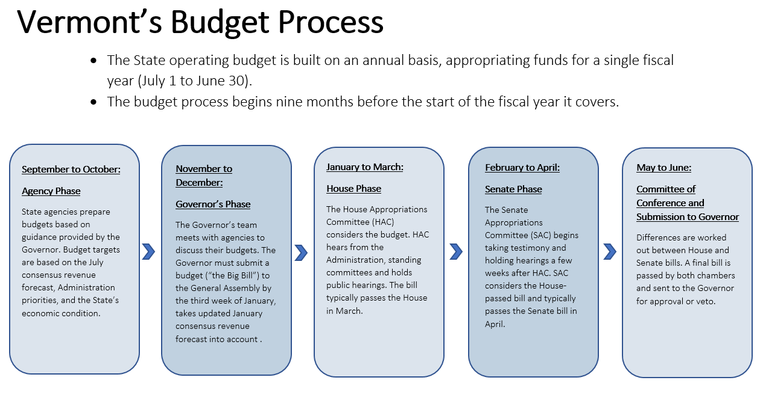

Slide 3
Reading the Budget
Different numbering structure from all other bills
Different numbering structure from the Budget Adjustment Act
Same numbering structure year to year (mostly)
A, B, C, D, and E sections
Plus some others…

Slide 4
A Sections
Annual explanatory sections
Purpose, definitions, and the legend
Outlines the authority being given to the Administration

Slide 5
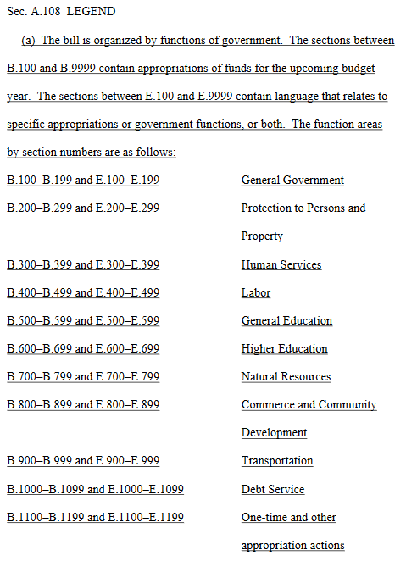

Slide 6
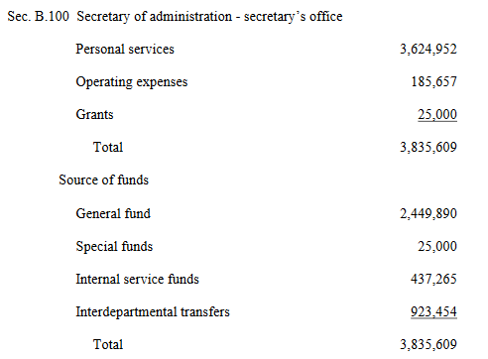
B Sections
Function area
“Numbers sections”
Base appropriations for the coming fiscal year
Match the current web report
Each function area shows where funds are going and where they’re coming from – but not in full detail
Allocations
Fund sources
Appropriations

Slide 7
Other B Sections
One-time appropriations for the coming fiscal year
One-time federal funds
Cash fund (Capital Bill)
Miscellaneous one-times

Slide 8
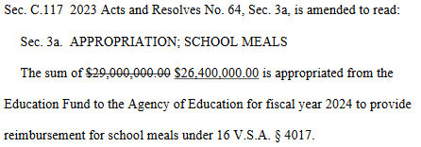
C Sections
Current year adjustments, appropriations, and amendments
We don’t catch everything in the Budget Adjustment Act, even though we try
The Budget is the next opportunity to make changes to the current fiscal year
Can address funding shortfalls, move funds, and change time-sensitive policy
Typically these sections are effective on passage

Slide 9
D Sections
Transfers, reversions, and reserve allocations for the coming fiscal year
D.100 – allocation of the property transfer tax
D.101 – fund transfers
D.102 – reversions

Slide 10
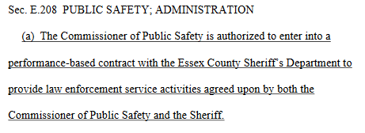
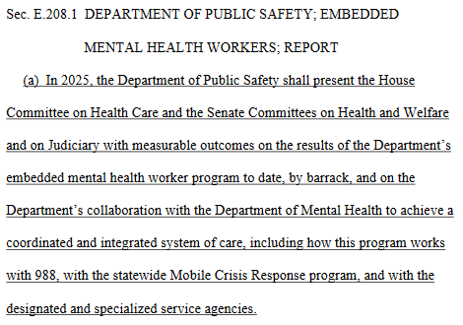
E Sections
Everything else, mostly
Language corresponding to the numbers sections
There isn’t an E section for every B section, but every E section links up with a B section
Mix of annual language and new language
Annual language will typically have the same number year to year
If two or more E sections relate to a particular B section, they’ll be numbered as .1, .2, etc.

Slide 11
F, G, H, I, J, K, L, M, N, O, P, Q, R, S, T, U, V, W, X, Y, and Z Sections
Change year to year
Sometimes aren’t in the bill at all
These are sections that get pulled into the bill
Act 113:
F Sections – financial regulation fees
G Sections – Pay Act
H Section – effective dates
The effective dates section is always last and always has its own section letter

Slide 12
Wrapping Up
A lot of the budget is annual language
Some of what’s in the Governor’s recommended budget will get pulled into the Budget Adjustment Act
Things that are missed in the Budget Adjustment Act will get pulled into the budget
A Sections explain the bill
B Sections appropriate
C Sections affect the current fiscal year
D Sections move money around
E Sections contain language relating to corresponding B Sections
Other sections vary year to year and come from other bills

