Slide 1
The Budget Adjustment
Senate Appropriations Committee
Emily Byrne, Deputy Fiscal Officer, Joint Fiscal Office
January 15, 2025

Slide 2
Adjusting the Budget
An overview of the Budget Adjustment process

Slide 3
The Budget Building Timeline
August 31, 2023
The Governor released the fiscal year 2025 budget instructions to Agencies and Departments
January 23, 2024
The Governor presented the fiscal year 2025 budget to the General Assembly
May 23, 2024
The Governor signed the fiscal year 2025 budget into law

Slide 4
The State Budget
It’s been 18 months since the fiscal year 2025 budget process started
Notes:
Things change

Slide 5
A Budget is a Plan
A budget is how the State plans to spend the revenues it estimates it will be available in a fiscal year
A lot of assumptions are made to help craft that help inform the plan
Notes:
Things change

Slide 6
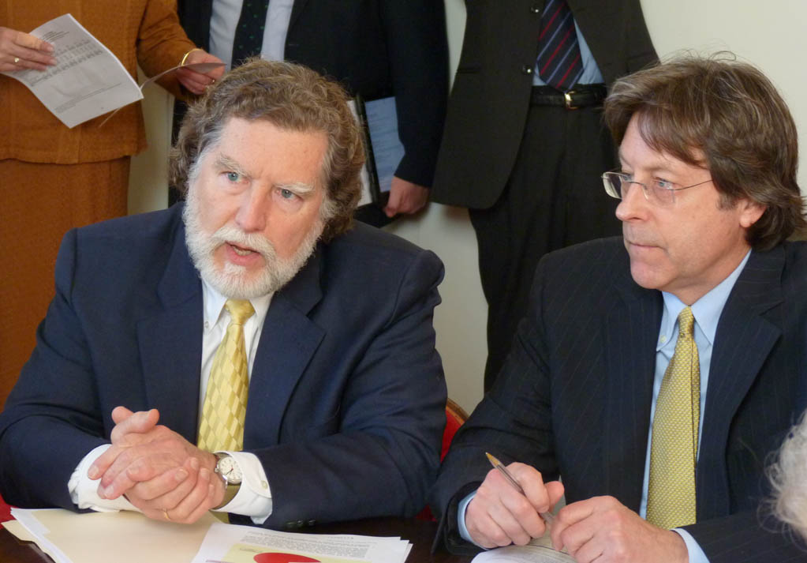
Things Change – Revenue
The Emergency Board met on July 31, 2024 and adopted a new revenue forecast for the General Fund, resulting in an approximately $172.0 million in additional forecasted revenue in fiscal year 2025
The Emergency Board will meet again on January 22 and adopt yet another revenue forecast for fiscal year 2025
The Emergency Board also adopts forecasts for the Transportation Fund and the Education Fund
More experience with Special Fund receipts
Notes:
Things change

Slide 7
Things Change – Expenses
The budget was built assuming certain things:
Caseload/enrollment in benefit programs
How much it is going to snow
How Vermonters will utilize government services
Whether or not there will be a flood
What is going to happen in the economy
The price of gas
The cost of State employee benefits
The rate of inflation
The list goes on…
Notes:
Things change

Slide 8
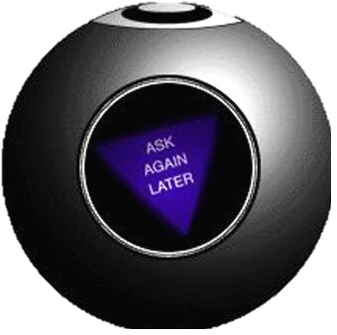
Things Change – Expenses
The assumptions and estimates used to build the budget are typically wrong:
More or fewer people enrolled in programs
It snowed more or less than we thought it would
More or fewer Vermonters utilized services
There was a flood
Something happened in the economy
The price of gas was different than was assumed
Employee health care costs went up more or less than anticipated
The rate of inflation was different than was assumed
The list goes on…
Notes:
Things change

Slide 9
Other Issues You Might Hear About in the Budget Adjustment
Receipts aren’t meeting projections
Cost per case is increasing/decreasing
Projections were not met
Unable to hire staff
Projects started late
Savings weren’t realized
RFP came in higher/lower than anticipated
Net neutral transactions – appropriations made in the wrong place
SLA agreement changed
Vacancy savings weren’t realized
Notes:
Things change

Slide 10
Enter the Budget Adjustment Act
Frequently referred to as the “BAA”

Slide 11
The Budget Adjustment Act
A mid-fiscal year opportunity to make updates to the current fiscal year budget
A chance to both appropriate unforeseen revenue and address unplanned expenses
Notes:
Things change

Slide 12
The Budget Adjustment
Meant to be a technical adjustment to appropriations based on new information
Incorporating changes outlined in the Letter of Intent
The budget is not always perfect
The Appropriations Chairs will issue a Letter of Intent to address issues and provide additional guidance to the Administration
FY 2024 Letter of Intent
FY 2024 Addendum to the Letter of Intent
Notes:
Things change

Slide 13
Timeline
The Budget Adjustment is typically presented early in the legislative session because it impacts the current fiscal year budget
Typically, one of the first bills the General Assembly passes
Note, it is not the last time that the General Assembly can adjust the current fiscal year budget
The “C” Sections of the Appropriations Act make further changes to the current year budget – think “C” for “current year”
Notes:
Things change

