Slide 1
VEDA Presentation
2026 Legislative Session
Wednesday, January 7, 2026

Slide 2
What is VEDA?
Created by the General Assembly in 1974
Mission is “to contribute to Vermont’s economic vitality by providing a broad array of financing programs to eligible businesses that create jobs and help advance Vermont’s public policy goals.”
Since its inception, VEDA has provided more than $2.6 billion in financing assistance to thousands of Vermont entrepreneurs, manufacturers, small businesses, and agricultural enterprises to enhance the vitality of Vermont’s economy.

Slide 3

Where does VEDA get its money?
VEDA borrows money from banking market and lends it out to fulfill its mission.
Other sources include Federal (USDA- IRP) and specific State Program appropriations such as DRLF.

Slide 4
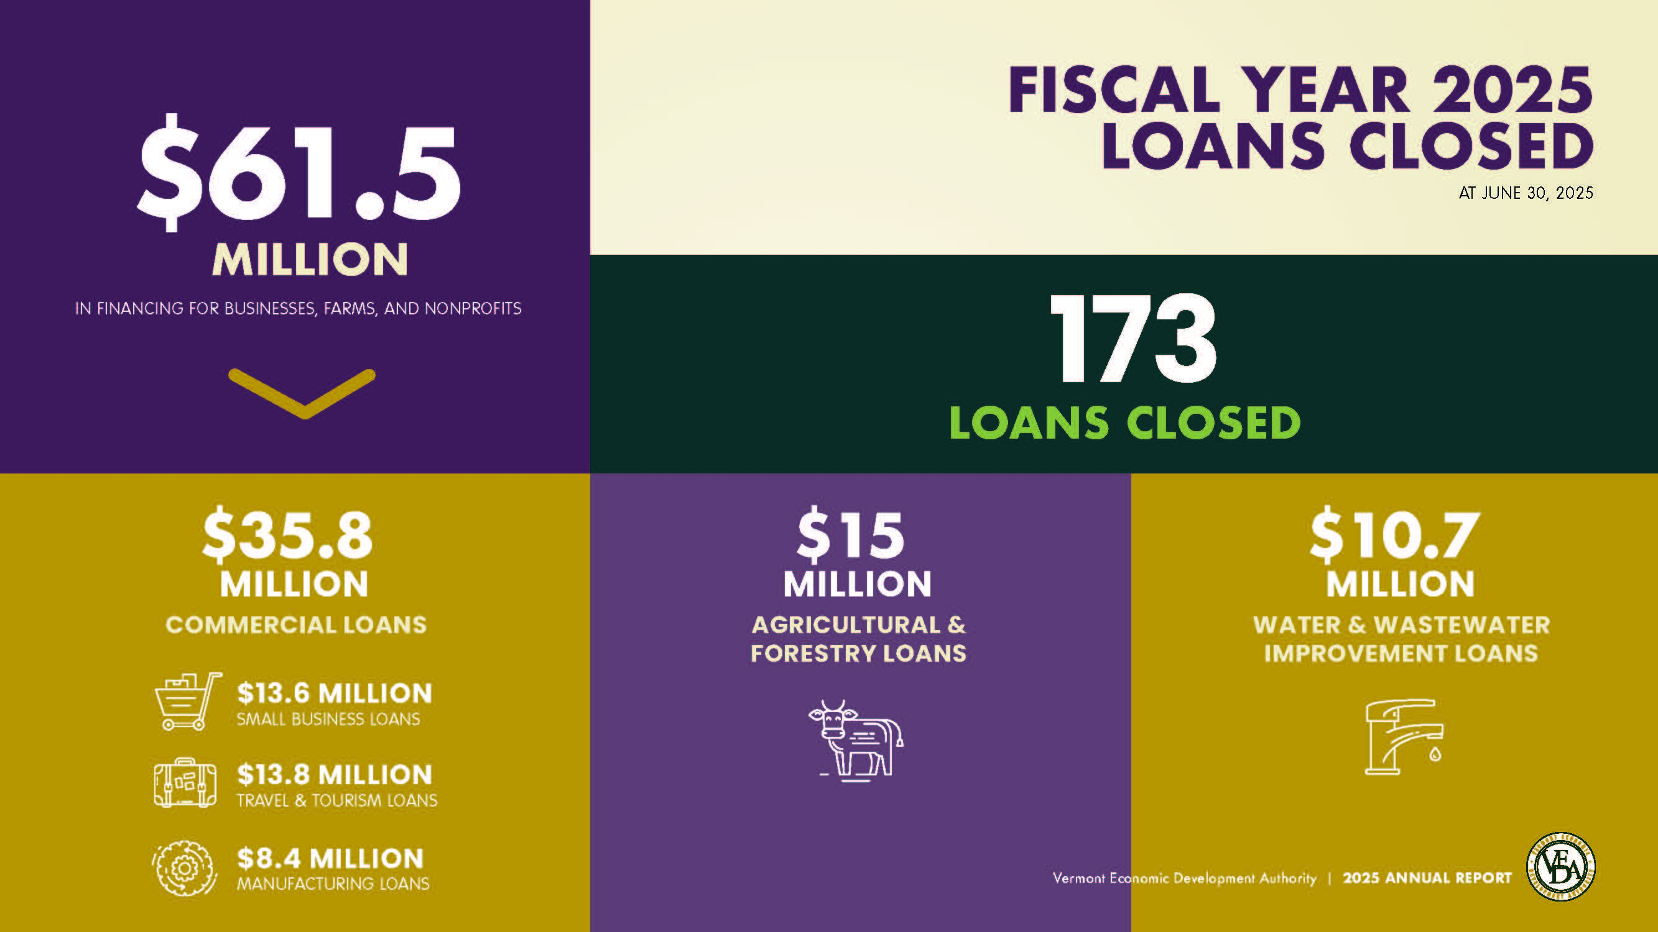

Slide 5



VEDA’s current loan portfolio
Agriculture Commercial Total Value
$70 Million $210 Million $280 Million

Slide 6
Agricultural Lending
Lend directly to farmers, forest-products enterprises.
Projects include expansions, land acquisition, equipment purchases, working capital, and housing for farmworkers.
Occasionally fund projects alongside other lenders, but frequently VEDA is only lender involved in a project.

Slide 7

Commercial Lending
70% of VEDA Commercial Loans involve at least one other lender.
Mostly participate with Community National Bank and Mascoma Bank.
Projects include downtown development, hotels, manufacturing, expansions, land acquisition, equipment purchases, working capital, energy investments, and more.

Slide 8
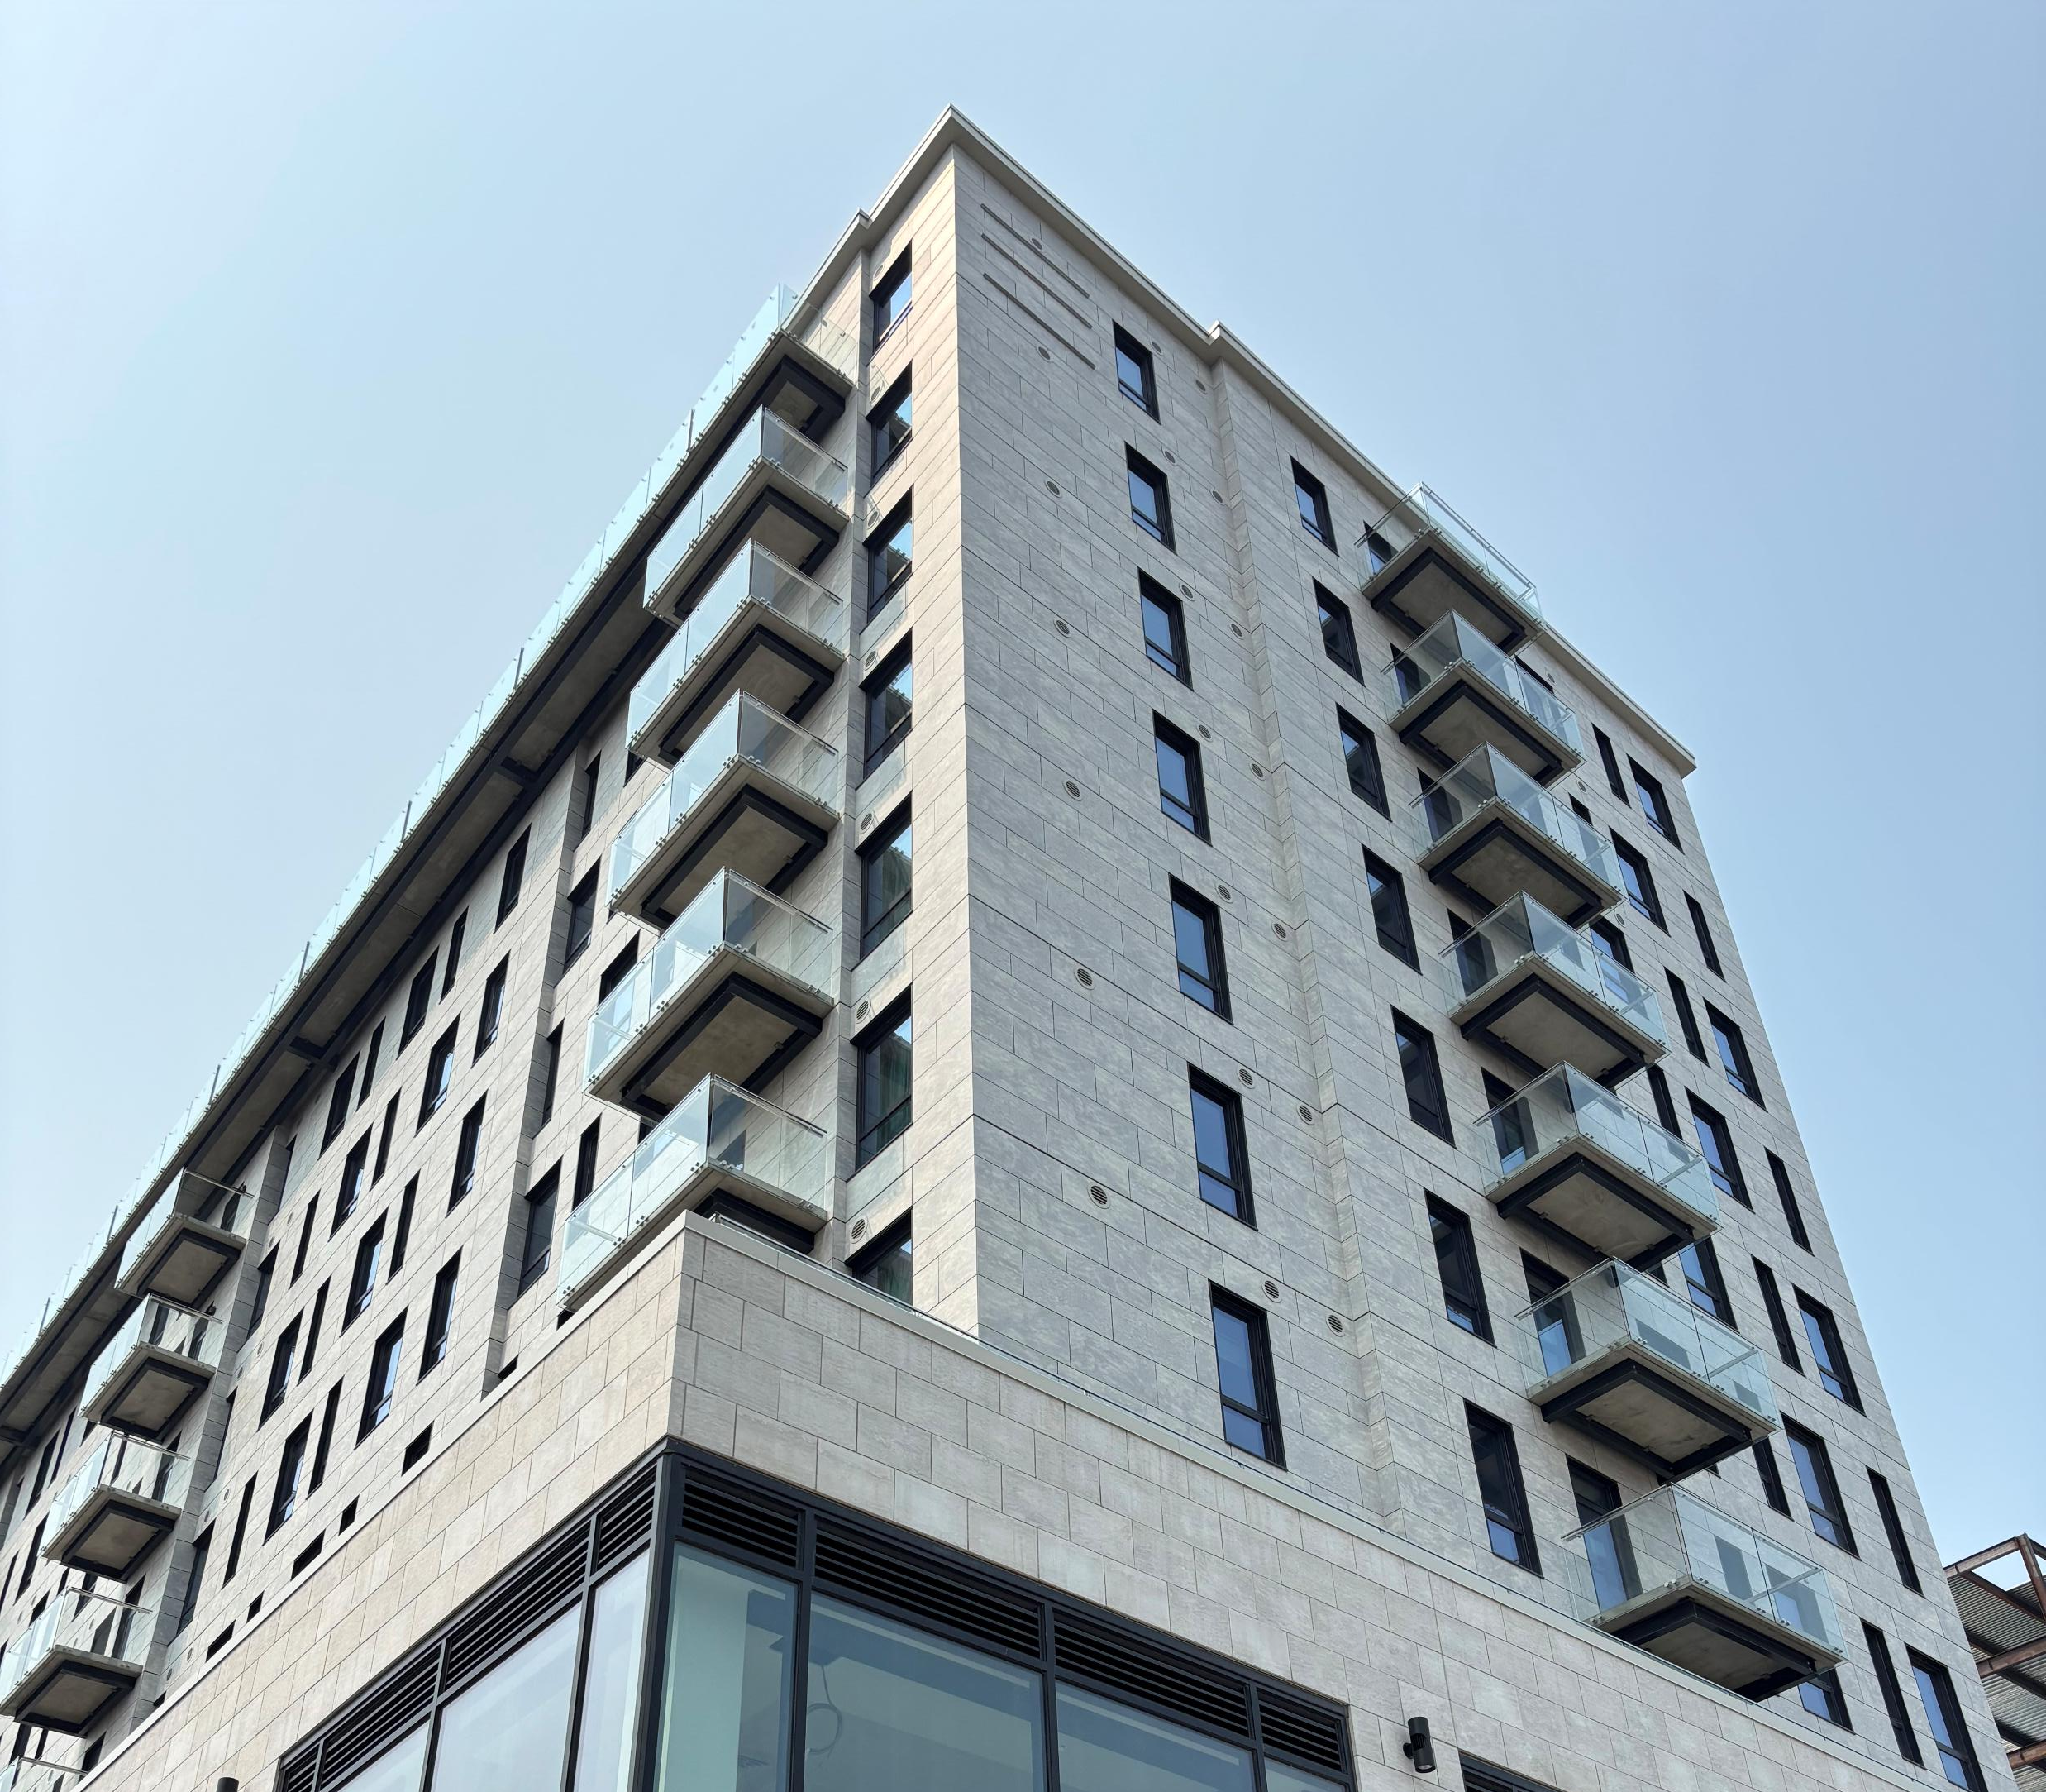
Recent VEDA commercial investments
AC Hotel Burlington
Benn High
Farmer and the Bell Café
Vergennes Animal Hospital
Landgrove Inn
Essex Resort & Spa
Turtle Island Children’s Center
Lyndonville Bagel Depot

Slide 9

Historical VEDA commercial investments
Mamava
Ben & Jerry’s
Blake Hill Preserves
OnLogic
Black River Produce
Green Mountain Coffee Roasters
Hubbardton Forge
Cabot Creamery

Slide 10

Why does VEDA want to get into housing?
Vermont is in a housing crisis.
VEDA is an Economic Development Authority created to help economy.
Economy needs housing.
Housing would be extension of our commercial portfolio.
VEDA has flexibility and can help projects get across the finish line when they otherwise may not. We help fill gaps.

Slide 11
Why does VEDA want to get into housing?
Already have commercial banking partnerships and Multi-Unit Housing Development is within the CRE Portfolio of those banks.
We make ourselves available to banks or credit unions that need or want us in the transaction.
Banks expressed interest in VEDA’s possible participation.

Slide 12
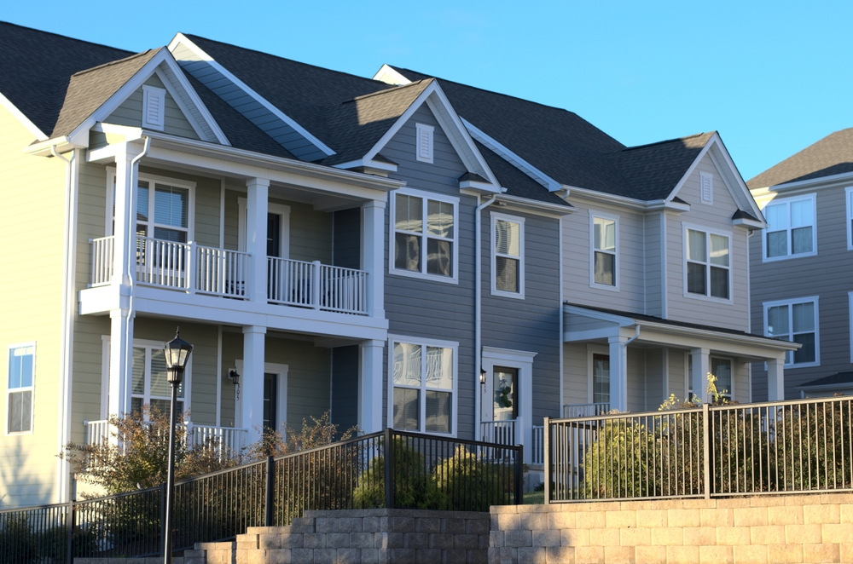
Current limitations
Letter sent from this committee to leaders of VEDA and VHFA encouraging collaboration, but VEDA is not brought into discussions for potential lending opportunities for multi-unit housing (some exceptions include Winston Prouty, Hula, etc.) because marketplace knows VEDA cannot lend to housing, making the actual gap analysis hypothetical.

Slide 13
Proposed housing language
“After consultation with and deference to the Vermont Housing Finance Agency on applications that are eligible for financing from both the Authority and the Agency, financing for multi-unit ( 5+) housing developments jointly financed with another lender or lenders when requested by said lender(s). ”
*Changing statute to allow VEDA to lend to housing does not force banks or credit unions to work with VEDA*

Slide 14

How liquidity spurs housing development
More capital could help build more housing.
VEDA’s lower rates (currently between 1% and 2% less than market) could make it easier for more housing projects to make it to the finish line.
If a bank or credit union wants some exposure but not all in a project, VEDA could fill that gap. Possible concentration limits, exposure limits, etc.

Slide 16
VEDA Presentation
2026 Legislative Session
Wednesday, January 7, 2026

