Slide 1
Required Agricultural Practices
Statute, Scope, and Application

Slide 2
Current Statute—6 V.S.A. §4810(b)
(b) Required Agricultural Practices. Required Agricultural Practices (RAPs) shall be management standards to be followed by all persons engaged in farming in this State. These standards shall address activities that have a potential for causing agricultural pollutants to enter the groundwater and waters of the State, including dairy and other livestock operations plus all forms of crop and nursery operations and on-farm or agricultural fairground, registered pursuant to 20 V.S.A. § 3902, livestock and poultry slaughter and processing activities. The RAPs shall include, as well as promote and encourage, practices for farmers in preventing agricultural pollutants from entering the groundwater and waters of the State when engaged in animal waste management and disposal, soil amendment applications, plant fertilization, and pest and weed control.

Slide 3
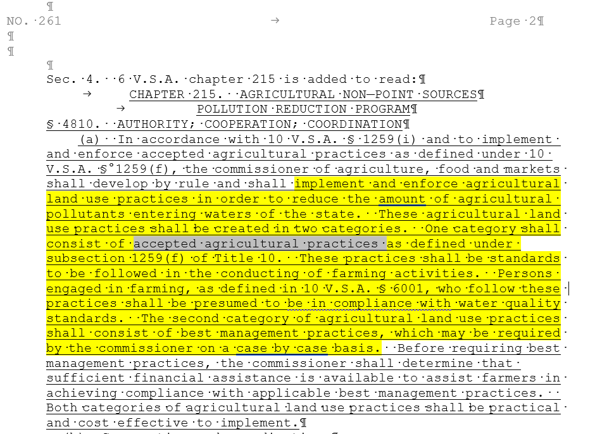
As Originally Enacted in 1991:
6 V.S.A. §4810(a)

Slide 4
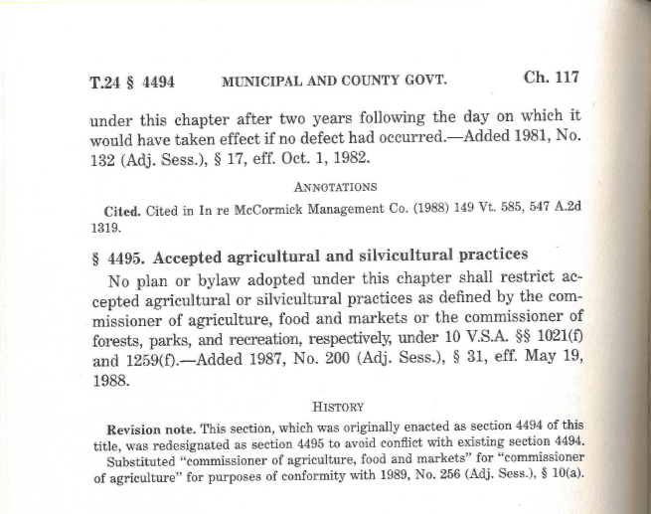
Municipal Exemption from Zoning Predated AAPs and RAPs

Slide 5
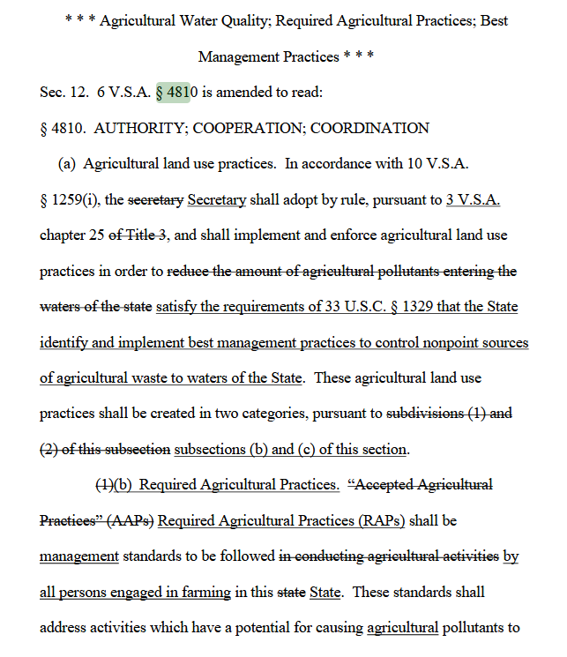
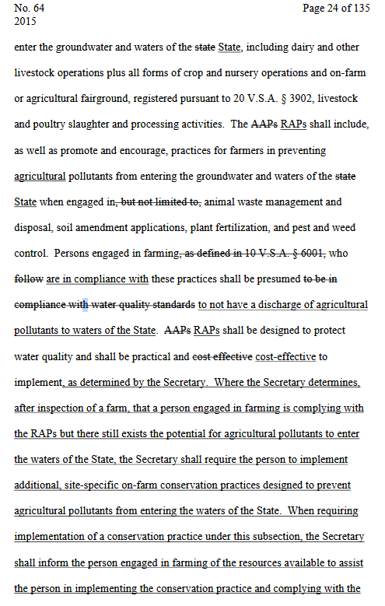
2015 Acts & Resolves No. 64:
When Accepted Became Required

Slide 6
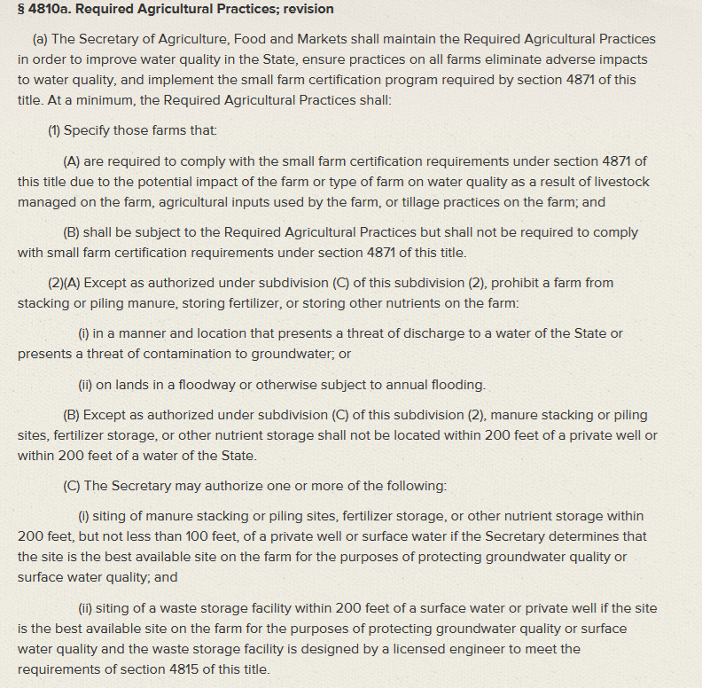
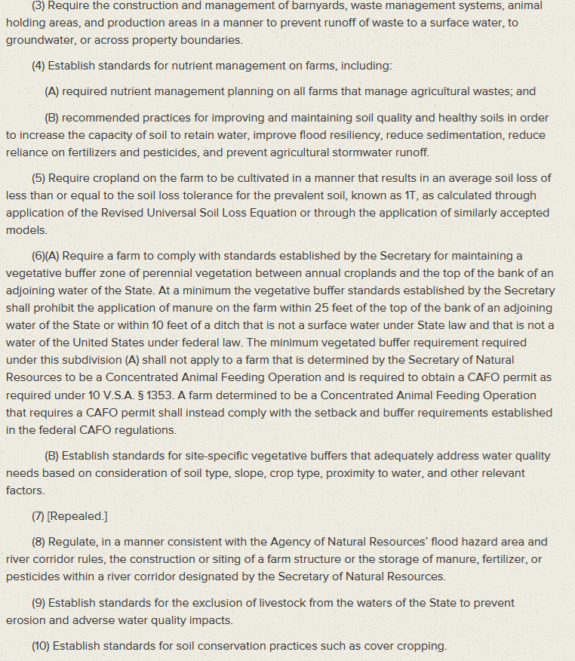
Act 64--Specific Statutory Required Agricultural Practices

Slide 7
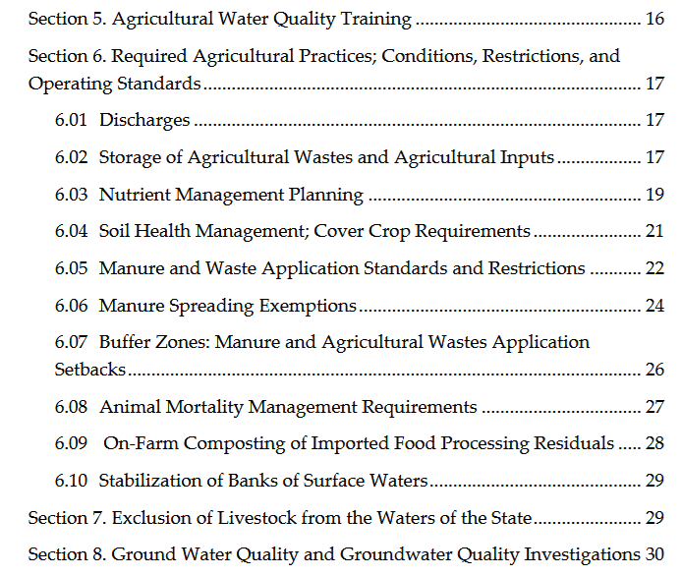

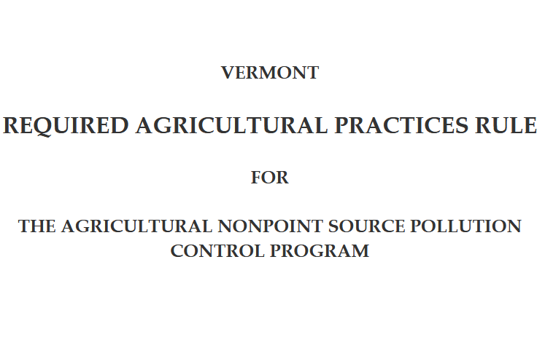
Yes, the RAPs Are Practices to Control Nonpoint Sources of Agricultural Waste to Waters

Slide 8
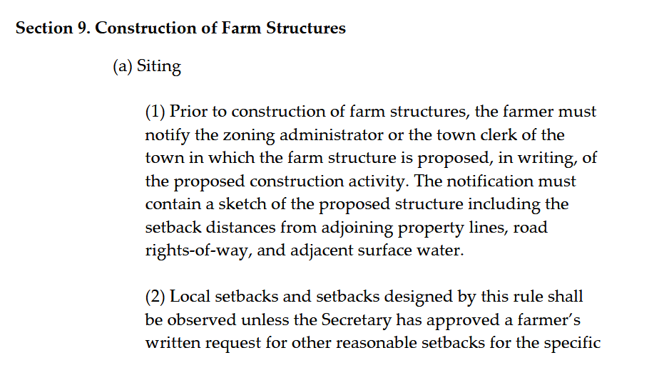
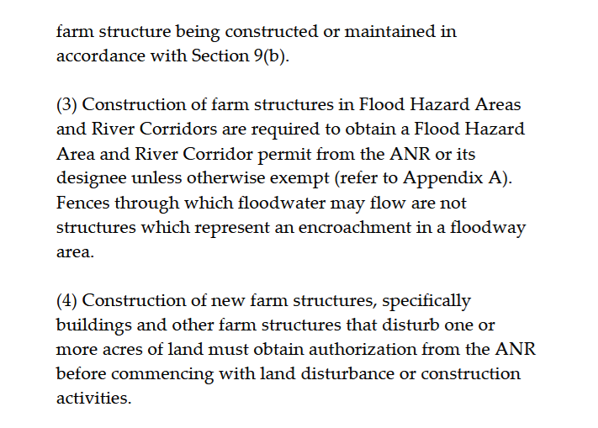
But, the RAPs Are More Than Just Water

Slide 9
In re 8 Taft Street DRB & NOV Appeals
“Accordingly, § 4413(d)(1)(A) does not prohibit all municipal regulation of farming if that farming is subject to the RAPs Rule, and landowner’s duck-raising operation is not exempt from municipal zoning solely because his activities are subject to the RAPs Rule. Rather, §4413(d)(1)(A) prohibits municipal regulation of “required agricultural practices,” or the agricultural land-management standards intended to protect Vermont’s waters established by the RAPs Rule and imposed on certain “agricultural practices.” We therefore reverse the Environmental Division’s decision granting summary judgment to landowner.”
But…
The Construction of Farm Structures is About More than Protection of Vermont’s Waters

Slide 10
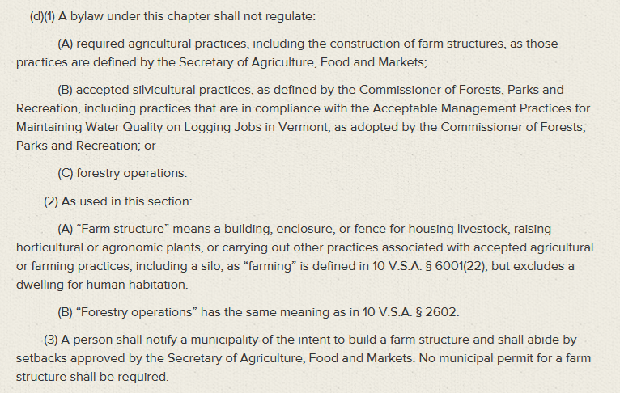
24 V.S.A. §4813(d)

Slide 11
Taft Supreme Court Acknowledged
In Moore, we examined whether buildings used for timber processing were “farm structures” used to conduct practices related to farming and were therefore exempt from municipal regulation.
We rejected the neighbors’ argument that cutting and planing wood was a manufacturing—not farming—activity while recognizing that lumber processing and harvesting “are practices long and intimately associated with farming in Vermont.”
We further acknowledged that this conclusion was bolstered by the fact that § 4413 reflects recognition by the Legislature “that, in order to survive, Vermont farms must enjoy the freedom to ‘diversify’ and engage in ‘reasonable agricultural activities’ ”.
We did not, however, address the meaning of “required agricultural practices,” and our interpretation of the term “farm structure”—a term specifically defined by the Legislature in 24 V.S.A. § 4413(d)(2)(A)—has no bearing on how the Secretary has defined “required agricultural practices.”
So Are Farm Structures Structures Regulated Under the RAPs Exempt from Municipal Bylaws, But the Rest of the RAPs Are Not?
Does the RAP Variance Process Still Apply?

Slide 12
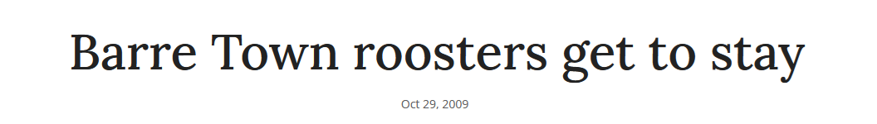
RAPs Define Scope of Farming
The RAPs are used throughout statute to refer to the activity that the Agency of Agriculture will regulate as farming.
The minimum animal thresholds or criteria for application of RAPs to an activity are intentional, not anomalous, so that the Agency of Agriculture is not required to regulate backyard farmers of allow backyard farmers to claim exemption from municipal zoning.

Slide 13
The RAPs Also Define Scope of Other Statutes
10 V.S.A. §1259 (water discharge): Provided a CAFO permit is not required, “the following activities shall not require a VPDES permit under section 1263 of this title: (1) required agricultural practices, as adopted by rule by the Secretary of Agriculture, Food and Markets;”
10 V.S.A. 1266b (application of fertilizer): (d) Application of fertilizer to impervious surface; in proximity to water; and seasonal restriction. No person shall apply any fertilizer: (1) to an impervious surface. Fertilizer applied or released to an impervious surface shall be immediately collected and returned to a container for legal application. This subdivision shall not apply to activities regulated under the required agricultural practices as those practices are defined by the Secretary of Agriculture, Food and Markets under 6 V.S.A. § 4810;
24 V.S.A. §4414(9) (municipal stormwater management and control): Any municipality may adopt bylaws to implement stormwater management and control consistent with the program developed by the Secretary of Natural Resources pursuant to 10 V.S.A. § 1264. Municipalities shall not charge an impervious surface fee or other stormwater fee under this subdivision or under other provisions of this title on property regulated under the Required Agricultural Practices for discharges of agricultural waste or agricultural nonpoint source pollution.

Slide 14
Summary
The General Assembly enacted the RAP requirements to address water quality.
But, the RAPs have been used to define the scope of farming subject to regulation by the Agency of Agriculture.
The agricultural exemption from municipal regulation has existed since 1987, 1987 Acts & Resolves No. 200, and was recodified and restructured within 24 V.S.A. §4413 by 2023 Acts & Resolves No. 115.
Was Taft Consistent with the Intent of the Legislature?

